Slide 1
Retrieving Data Using the SQL SELECT Statement

Slide 2
Objectives
After completing this lesson, you should be able to do the following:
List the capabilities of SQL SELECT statements
Execute a basic SELECT statement
Differentiate between SQL statements and SQL Developer commands

Slide 3
Capabilities of SQL SELECT Statements
Projection
Selection
Table 1
Table 1
Join
Table 1
Table 2

Slide 4
Basic SELECT Statement
SELECT *|{[DISTINCT] column|expression [alias],...}
FROM table;
SELECT identifies the columns to be displayed
FROM identifies the table containing those columns

Slide 5
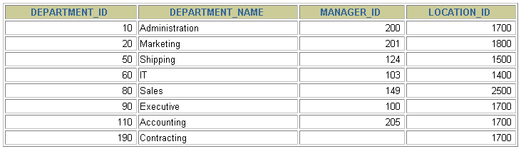
Selecting All Columns
SELECT *
FROM departments;

Slide 6
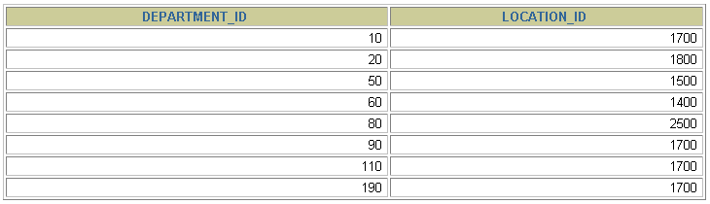
Selecting Specific Columns
SELECT department_id, location_id
FROM departments;

Slide 7
Writing SQL Statements
SQL statements are not case-sensitive.
SQL statements can be on one or more lines.
Keywords cannot be abbreviated or split across lines.
Clauses are usually placed on separate lines.
Indents are used to enhance readability.
In SQL Developer, SQL statements can optionally be terminated by a semicolon (;). Semicolons are required if you execute multiple SQL statements.
In SQL*Plus, you are required to end each SQL statement with a semicolon (;).

Slide 8
Column Heading Defaults
SQL Developer:
Default heading alignment: Center
Default heading display: Uppercase
SQL*Plus:
Character and Date column headings are left- aligned
Number column headings are right-aligned
Default heading display: Uppercase
Notes:
…

Slide 9
Arithmetic Expressions
Create expressions with number and date data by using arithmetic operators.
Operator | Description
+ | Add
- | Subtract
* | Multiply
/ | Divide

Slide 10
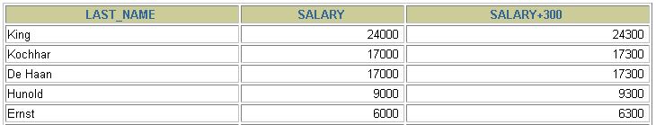
Using Arithmetic Operators
SELECT last_name, salary, salary + 300
FROM employees;
…

Slide 11


Operator Precedence
SELECT last_name, salary, 12*salary+100
FROM employees;
1
…
SELECT last_name, salary, 12*(salary+100)
FROM employees;
2
…

Slide 12
Defining a Null Value
A null is a value that is unavailable, unassigned, unknown, or inapplicable.
A null is not the same as a zero or a blank space.
SELECT last_name, job_id, salary, commission_pct
FROM employees;
…
…

Slide 13
Null Values in Arithmetic Expressions
Arithmetic expressions containing a null value evaluate to null.
SELECT last_name, 12*salary*commission_pct
FROM employees;
…
…

Slide 14
Defining a Column Alias
A column alias:
Renames a column heading
Is useful with calculations
Immediately follows the column name (There can also be the optional AS keyword between the column name and alias.)
Requires double quotation marks if it contains spaces or special characters or if it is case-sensitive

Slide 15


Using Column Aliases
SELECT last_name AS name, commission_pct comm
FROM employees;
…
SELECT last_name "Name" , salary*12 "Annual Salary"
FROM employees;
…

Slide 16

Concatenation Operator
A concatenation operator:
Links columns or character strings to other columns
Is represented by two vertical bars (||)
Creates a resultant column that is a character expression
SELECT last_name||job_id AS "Employees"
FROM employees;
…

Slide 17
Literal Character Strings
A literal is a character, a number, or a date that is included in the SELECT statement.
Date and character literal values must be enclosed by single quotation marks.
Each character string is output once for each row returned.

Slide 18
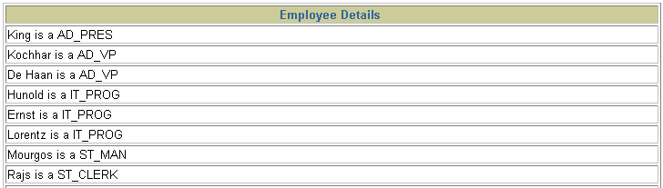
Using Literal Character Strings
SELECT last_name ||' is a '||job_id
AS "Employee Details"
FROM employees;
…

Slide 19

Alternative Quote (q) Operator
Specify your own quotation mark delimiter
Choose any delimiter
Increase readability and usability
SELECT department_name ||
q'[, it's assigned Manager Id: ]'
|| manager_id
AS "Department and Manager"
FROM departments;
…

Slide 20


Duplicate Rows
The default display of queries is all rows, including duplicate rows.
SELECT department_id
FROM employees;
1
…
SELECT DISTINCT department_id
FROM employees;
2
…

Slide 21



SQL and SQL Developer Interaction
SQL statements
Oracle
server
SQL Developer
commands
Query results
Formatted report
Client

Slide 22
SQL Statements Versus SQL Developer Commands
SQL
A language
ANSI standard
Keyword cannot be abbreviated.
Statements manipulate data and table definitions in the database.
SQL Developer
An environment
Oracle-proprietary
Keywords can be abbreviated.
Commands do not allow manipulation of values in the database.
SQL
statements
SQL Developer
commands

Slide 23
Displaying Table Structure
Use the SQL Developer
DESCRIBE command to display the structure of a table:
DESC[RIBE] tablename

Slide 24
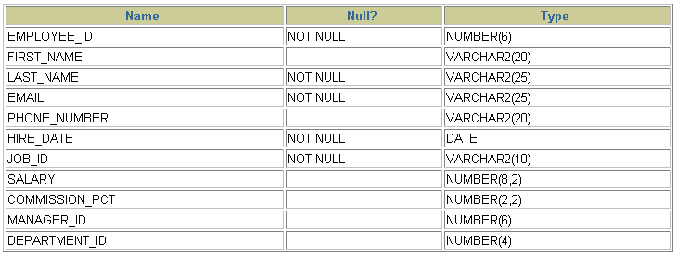
Displaying Table Structure
DESCRIBE employees

Slide 25
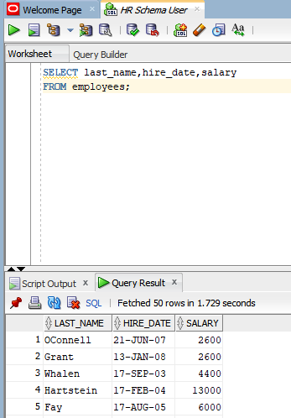
Interacting with Script Files

Slide 26
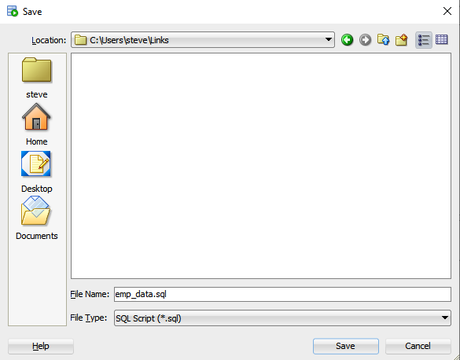
Interacting with Script Files

Slide 27
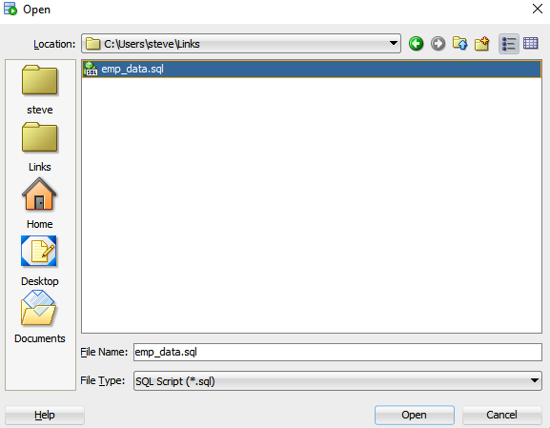
Interacting with Script Files

Slide 28
Interacting with Script Files

Slide 29
Summary
In this lesson, you should have learned how to:
Write a SELECT statement that:
Returns all rows and columns from a table
Returns specified columns from a table
Uses column aliases to display more descriptive column headings
Use the SQL Developer environment to write, save, and execute SQL statements and SQL Developer commands
SELECT *|{[DISTINCT] column|expression [alias],...}
FROM table;

Slide 30
Practice 1: Overview
This practice covers the following topics:
Selecting all data from different tables
Describing the structure of tables
Performing arithmetic calculations and specifying column names
Using SQL Developer
Notes:
Practice 1: Overview
This is the first of many practices in this course. Practices are intended to cover all topics that are presented in the corresponding lesson.
Start SQL Developer.
Perform the practices slowly and precisely. You can experiment with saving and running command files. If you have any questions at any time, ask your trainer.

Slide 31
Notes:
Practice 1
Part 1
Test your knowledge:
1. Initiate an SQL Developer session using the user ID and password that was provided during installation
2. SQL Developer commands access the database. True/False
3. The following SELECT statement executes successfully:
SELECT last_name, job_id, salary AS Sal FROM employees;
True/False
4. The following SELECT statement executes successfully:
SELECT *
FROM job_grades;
True/False
5. There are four coding errors in the following statement. Can you identify them?
SELECT employee_id, last_name
sal x 12 ANNUAL SALARY
FROM employees;
Part 2
You have been hired as a SQL programmer for Acme Corporation. Your first task is to create some reports based on data from the Human Resources tables.
6. Your first task is to determine the structure of the DEPARTMENTS table and its contents.

Slide 32
Notes:
Practice 1 (continued)
7. You need to determine the structure of the EMPLOYEES table.
The HR department wants a query to display the last name, job code, hire date, and employee number for each employee, with employee number appearing first. Provide an alias STARTDATE for the HIRE_DATE column. Save your SQL statement to a file named lab_01_07.sql so that you can disperse this file to the HR department.

Slide 33
Notes:
Practice 1 (continued)
Test your query in the lab_01_07.sql file to ensure that it runs correctly.
9. The HR department needs a query to display all unique job codes from the EMPLOYEES table.

Slide 34
Notes:
Practice 1 (continued)
Part 3
If you have time, complete the following exercises:
10. The HR department wants more descriptive column headings for its report on employees. Copy the statement from lab_01_07.sql to the editor in SQL Developer. Name the column headings Emp #, Employee, Job, and Hire Date, respectively. Then run your query again.
11. The HR department has requested a report of all employees and their job IDs. Display the last name concatenated with the job ID (separated by a comma and space) and name the column Employee and Title.

Slide 35
Notes:
Practice 1 (continued)
If you want an extra challenge, complete the following exercise:
12. To familiarize yourself with the data in the EMPLOYEES table, create a query to display all the data from that table. Separate each column output by a comma. Name the column title THE_OUTPUT.

